Slide 1

Intro to Artificial Intelligence Dr. Shivanjali Khare

Slide 2

Detection of Credit Card Defaulters
Rajesh Kanneboyena- 00722139
Jayaprakash Dama- 00747524
Lakshmi Sowjanya Donadri- 00746430

Slide 3

Overview
Machine learning techniques are sweeping the commercial world, and the internet is already covered in ML models ranging from e-commerce to human care, and the list goes on.
We are predicting credit card defaulters in this project by training a data set using several machine learning techniques and comparing the results of each model. Machine Learning models like
SVM
Logistic Regression
Naive bayes
Random Forest

Slide 4

Approach
1. Get the data set via the API
2. Exploratory data analysis
3. ML model is used to train the data set
4. Predict the model with Test data
5. Metrics – Confusion matrix , F1 score, K Fold cross validation.
Retrieve Data
EDA
Train the Model
Predict the Model
Performance Evaluation

Slide 5

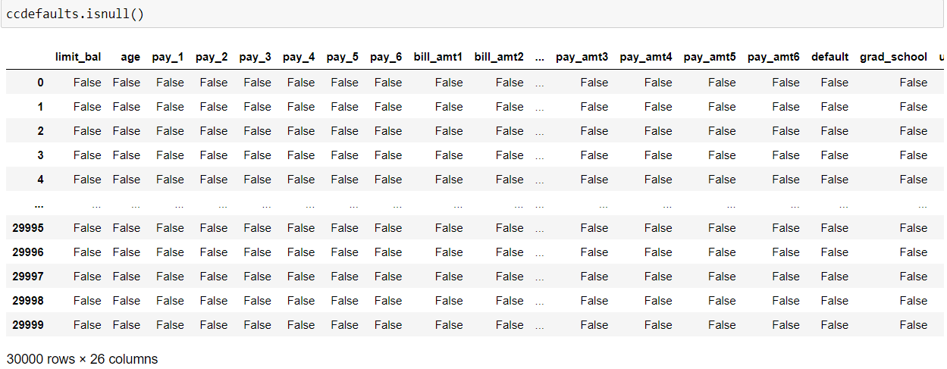
Feature Analysis
1. In the data set, I looked any missing values

Slide 6

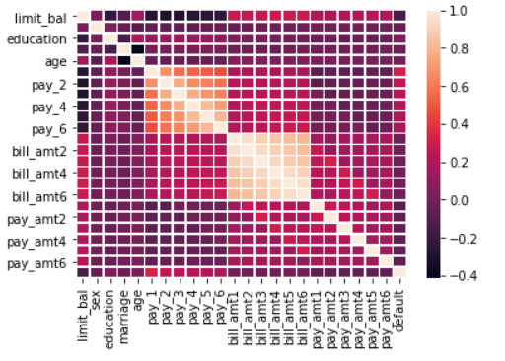
Feature Analysis
2. Correlation between features

Slide 7

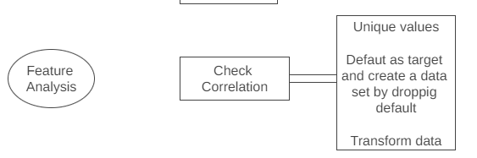
Feature Analysis
Find unique values in few columns
Transform the education and marital status columns' values
Set 'default’ as target and create a new dataset by dropping this column from original dataset
Use RobustScaler to transform the new data set from above

Slide 8

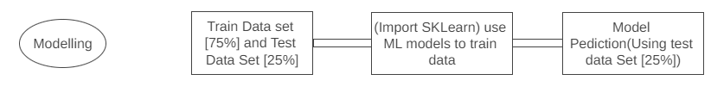
Modelling
Created the train and test data set
From SKLearn Imported the ML model
Performed train data set on those models
Using a test data set to predict the model
F1 score and confusion matrix were used to evaluate the model
K Fold Cross Validation is used to evaluate the model
A new dataset was used to test the model

Slide 9

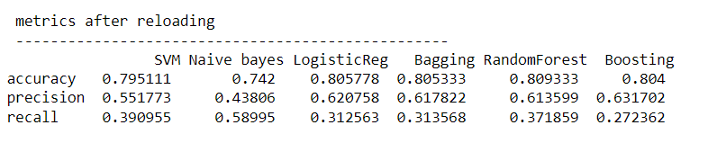
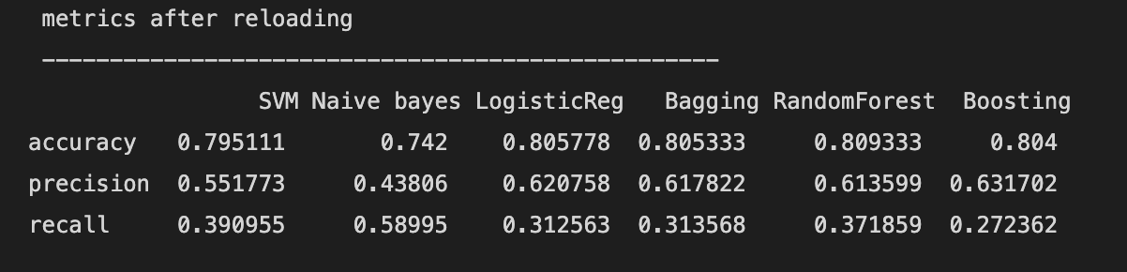
Performance
1. Following is the performance of each models used.

Slide 10
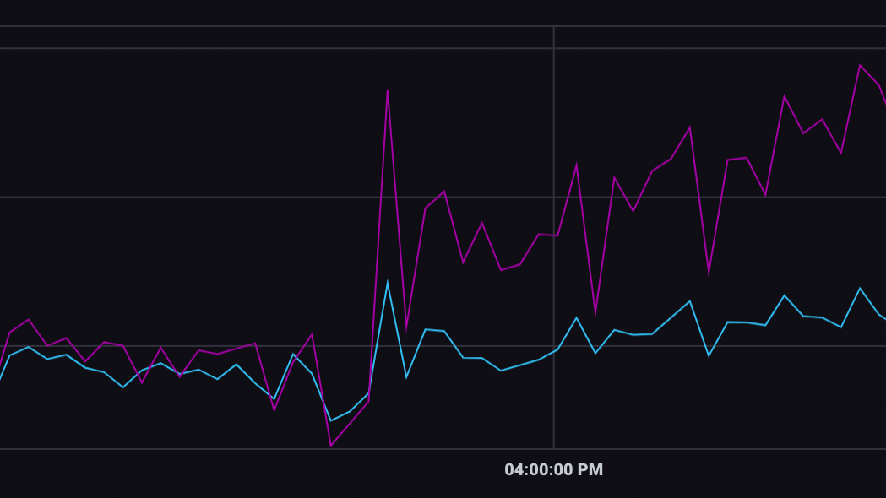
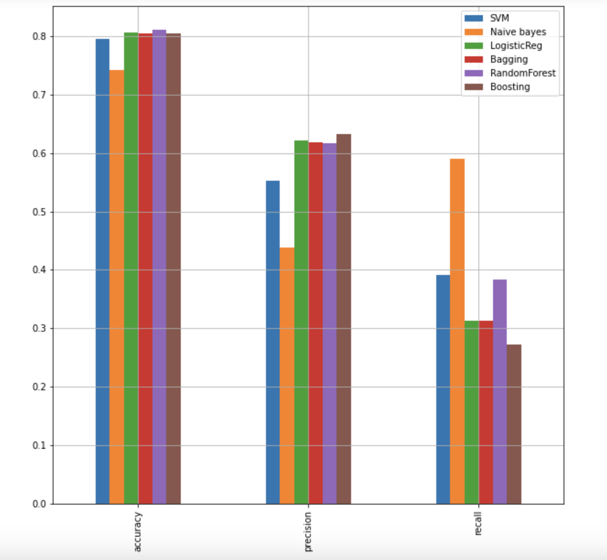
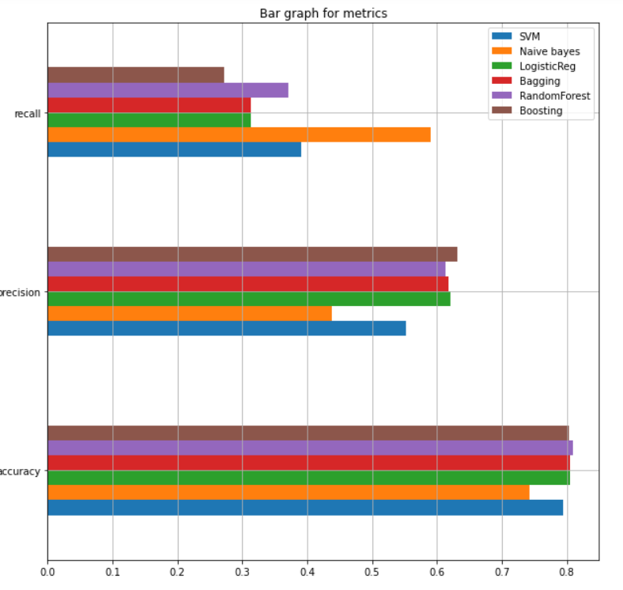
Performance
2. Representing the performance of
model visually by plotting bar graph

Slide 11

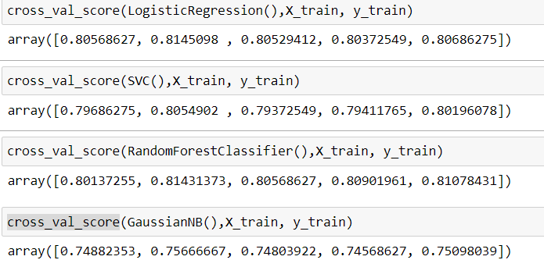
K Fold Cross Validation
We also used K Fold Cross Validation to assess the models

Slide 12

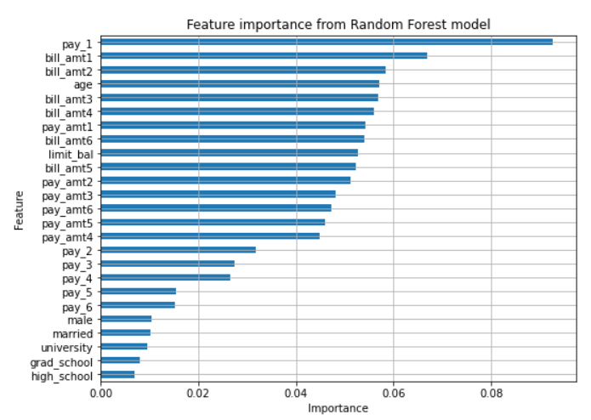
Calculating Feature importance for Random Forest
We calculated important features of the Random Forest Model because it performed well in comparison to other models.

Slide 13

References
https://rstudio-pubs-static.s3.amazonaws.com/281390_8a4ea1f1d23043479814ec4a38dbbfd9.html
Data retrieved from : https://archive.ics.uci.edu/ml/datasets/default+of+credit+card+clients
https://raw.githubusercontent.com/MLWave/Black-Boxxy/master/credit-card-default.csv

Slide 14

THANK YOU

